Slide 1
Chapter 2
Section 2.1-2.6

Slide 2
Variable
A C++ variable is an entity that is used to store data
Depending on the data you want to use, there are different data types of variables
Integers: Integer-type variables are used to store integer values
Typical uses in counting, serial numbers, etc.
Float, Double: Float–type variables are used to store decimal values
Typical used in arithmetic involving decimal points, etc.
Double has more precision but needs more memory to store
Character: Character-type variables are used to store character values
Typical uses in names, etc. that cannot be expressed by using just numbers

Slide 3
Variable
Declaration and Definition
int x; //declaring a variable x of type integer
float y; //declaring a variable y of type floating number
char c; //declaring a variable c of type character
int, float, char are C++ keywords and are the variable types
x, y and c here are variable names
A variable can store any appropriate value
x=5; //storing integer value 5 in variable x
y=3.1416; //storing decimal value 3.1416 in variable y
c=‘a’; // storing character ‘a’ in variable c

Slide 4
Variable
Variable can be declared and defined at the same time
int a=37; //declare an integer variable a and store value 37 in it
The value stored in a variable can be changed/varied
int a=10; //declare an integer variable a and store value 10 in it
a=5;// change the value stored in a to 5
The latest value stored in the variable is retained and the older ones are overwritten and cannot be recovered

Slide 5
Assignment Operator
Assigning in C++ refers to storing a specific value in a container by using the “equal to” (=) sign
‘=‘ is referred to as the assignment operator (actually one type of several assignment operators)
A variable can be assigned any appropriate value
A variable can also be assigned the value stored in another variable
int b=a; //declare an integer-type variable b and store the value //of a in it
A variable can also be assigned the value obtained by operations on variables
int c=a+b; //add variables a and b and store the value in variable c
Here a+b is the assignment statement

Slide 6
Assignment operator
Do not assign unsuitable values to variables
The code will either not compile or create unwanted errors
char c=65.1416; // will store 65 in character c, i.e. c=‘A’
int z=3.1416; // will store 3 in variable z causing loss of data

Slide 7
Naming variables
Variables names are called identifiers
Choosing variable names
Use meaningful names that represent data to be stored
First character must be
a letter
the underscore character
Remaining characters must be
letters
numbers
underscore character
Cannot use a reserved word– reserved word part of C++ language such as int or double

Slide 8
Chapter 2
Section 2.7

Slide 9
Scientific Notations
Floating point values can be written in scientific notations
Useful for short-hand writing of some common scientific numbers with high indices in power
For example,
double x=1.7e10; //x=17,000,000,000.00

Slide 10
Showing Decimal Places
cout includes tools to specify output of type double
To specify fixed point notation
setf(ios::fixed)
To specify that decimal point will always be shown
setf(ios::showpoint)
To specify two decimal places will always be shown
precision(2)
Example:
cout.setf(ios::fixed); cout.setf(ios::showpoint); cout.precision(2); cout << "The price is $" << price << endl;

Slide 11
Chapter 2
Section 2.8

Slide 12
Constants
There are values that never changes and/or should never change during the program
e.g. value of pi
C++ constants allows defining these values as constant parameters
This makes sure it cannot be changed by the user or the programmer
const float pi=3.1416; //define a constant float pi
float area=pi*r*r; // calculate area of a circle with radius r and //assign to variable area
pi=10; //compilation error, pi is a constant

Slide 13
Chapter 2
Section 2.9

Slide 14
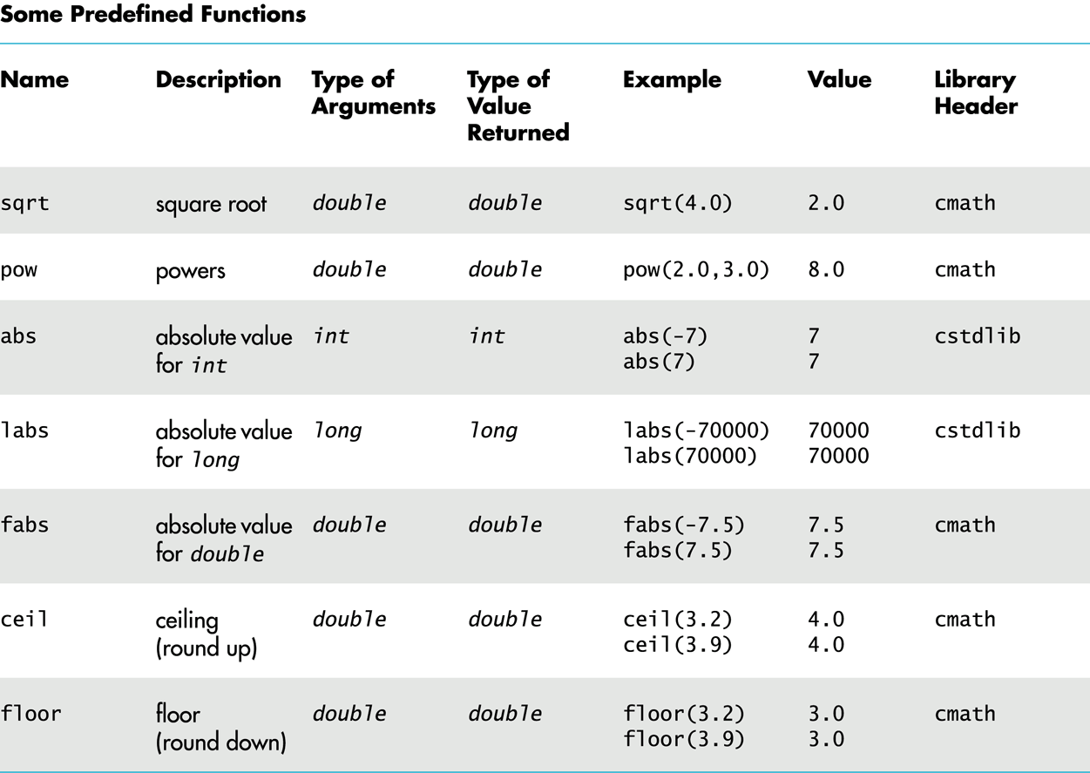
Typical Math Functions
Remember to
include these header files

Slide 15
Chapter 2
Section 2.9

Slide 16
Integer Division and Modulo
Diving an integer by another integer creates an integer as the quotient
For example,
int x=10; int y=3;
cout<<x/y; //Displays 3
%: Modulo operator, gives remainder
For example,
x=11%3; //this makes x=2

Slide 17
Chapter 2
Section 2.11

Slide 18
int-double Compatibility
Variables of type double should not be assigned to variables of type int int int_variable; double double_variable; double_variable = 2.00; int_variable = double_variable;
If allowed, int_variable contains 2, not 2.00
Integer values can normally be stored in variables of type double double double_variable; double_variable = 2;
double_variable will contain 2.0

Slide 19
Typecasting
Sometimes it becomes necessary to change data types
Implicit Casting
Data type is automatically converted to an elevated data type
Example
int my_int=10;
float my_float=my_int; //implicit conversion
Explicit Casting
Explicitly change the data type
Example
float my_float=10.5;
int my_int=(int) f; //explicitly change to integer
static_cast<type> expression can also be used for explicit casting
int my_int=7;
double my_double=static_cast<double>(my_int); //explicit casting
double my_double2=static_cast<double>(my_int+5); //explicit casting

Slide 20
Chapter 2
Section 2.12

Slide 21
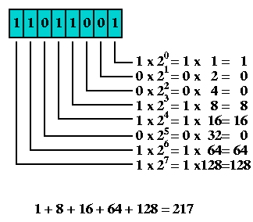
Binary-to-Decimal
The powers of 2 (binary) give us the decimal weights
This means that 11011001 is 217 in decimal

Slide 22
Decimal-To-Binary
Keep on diving the decimal number by 2 until we get 1 as quotient and collect the remainders, remember you can have only 1 or 0 as remainder
For example, if we want to find the binary equivalent of 217
Now, we read the binary numbers in opposite order of collection
Hence 10011001 is the binary equivalent of 217
Division Operation | Quotient | Remainder
217/2 | 108 | 1
108/2 | 54 | 0
54/2 | 27 | 0
27/2 | 13 | 1
13/2 | 6 | 1
6/2 | 3 | 0
3/2 | 1 | 0
1/2 | 0 | 1

Slide 23
Hexadecimal
decimal | binary | hexadecimal
0 | 0000 | 0
1 | 0001 | 1
2 | 0010 | 2
3 | 0011 | 3
4 | 0100 | 4
5 | 0101 | 5
6 | 0110 | 6
7 | 0111 | 7
8 | 1000 | 8
9 | 1001 | 9
10 | 1010 | A
11 | 1011 | B
12 | 1100 | C
13 | 1101 | D
14 | 1110 | E
15 | 1111 | F
Hexadecimal is base 16
Uses 16 digits
Why use Hex?
Binary numbers are too long
Example
What’s 0x2BAD in binary?
What’s 0x2BAD in decimal?
0 1 2 3 4 5 6 7
8 9 A B C D E F

Slide 24
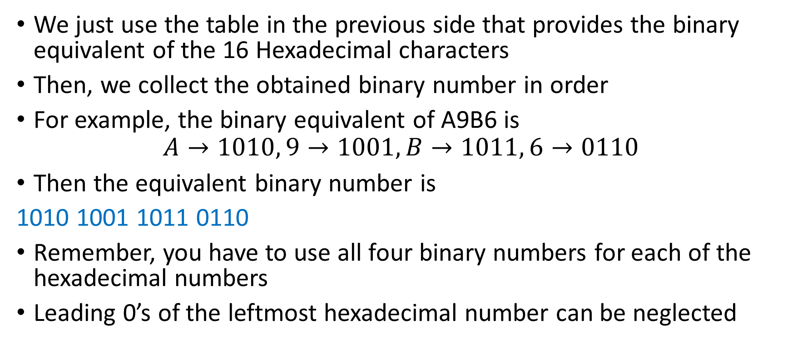
Hexadecimal-To-Binary
We just use the table in the previous side that provides the binary equivalent of the 16 Hexadecimal characters
Then, we collect the obtained binary number in order
For example, the binary equivalent of A9B6 is
$$A→1010, 9→1001,B→1011, 6→0110$$
Then the equivalent binary number is
1010 1001 1011 0110
Remember, you have to use all four binary numbers for each of the hexadecimal numbers
Leading 0’s of the leftmost hexadecimal number can be neglected

Slide 25
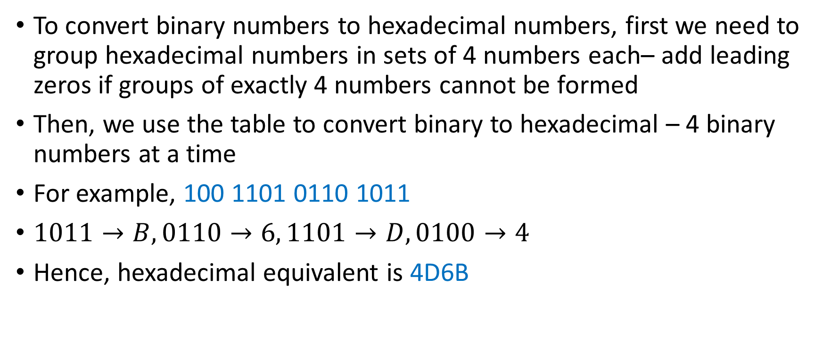
Binary-To-Hexadecimal
To convert binary numbers to hexadecimal numbers, first we need to group hexadecimal numbers in sets of 4 numbers each– add leading zeros if groups of exactly 4 numbers cannot be formed
Then, we use the table to convert binary to hexadecimal – 4 binary numbers at a time
For example, 100 1101 0110 1011
$1011→B, 0110→6, 1101→D, 0100→4$
Hence, hexadecimal equivalent is 4D6B

Slide 26
Chapter 2
Section 2.13

Slide 27
Characters
Refer to Slide #1 for examples

Slide 28
char-int Compatibility
It is possible to store char values in integer variables int value = 'A’;
value will contain an integer representing 'A'
It is possible to store int values in char variables char letter = 65;

Slide 29
Chapter 2
Section 2.14

Slide 30
Type string
string is a sequence of characters
Use double quotes around the text to store into the string variable
Requires the following be added to the top of your program (to use the string library)
#include <string>
To declare a variable of type string: string name = ”Walter Savitch";

Slide 31
Reading strings with cin
cin does not read whitespaces
Creates issues when you are attempting to enter a sequence of character separated by whitespaces
string name;
cout<<“Enter your full name:”;
cin>>name;
cout<<“You entered:”<<name;
We use getline to deal with such issues
cout<<“Enter your full name:”;
getline(cin,name);
cout<<“You entered:”<<name;
Sample Output:
Enter your full name: John Smith
You entered: John
Sample Output:
Enter your full name: John Smith
You entered: John Smith

Slide 32
Chapter 2
Section 2.15-2.16

Slide 33
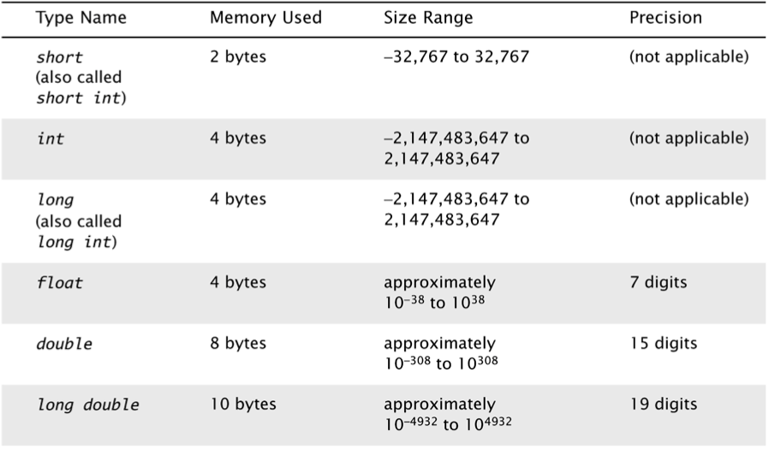
Numeric Datatypes
Various number types have different memory requirements
More precision requires more bytes of memory
Very large numbers require more bytes of memory; very small numbers require more bytes of memory
If you store a number beyond the range, numeric data will overflow
The memory used may differ for each system

Slide 34
Unsigned
If you know the value if always positive, use unsigned variable
Higher range, no need to store the sign bit
Example
unsigned int my_uint=100;
unsigned long my_ulong;

Slide 35
Chapter 2
Section 2.17

Slide 36
Random Number Generation
Really pseudo-random numbers
Seed the random number generator only once
#include <cstdlib>
#include <ctime>
…
srand(time(NULL));
The rand() function returns a random integer that is greater than or equal to 0 and less than RAND_MAX
rand();
Library dependent, but guaranteed to be at least 32767 (in cstdlib)

Slide 37
Random Numbers
Use % (range) and + (offset) to scale to the number range you want
For example to get a random number from 1 – 6 to simulate rolling a six-sided die:
int die = (rand() % 6) + 1; // % is the remainder operator
Can you simulate rolling two dice?
Generating a random number x where 10 < x < 21?

Slide 38
Chapter 2
Section 2.18

Slide 39
Debugging
Refer to Zybook

Slide 40
Chapter 2
Section 2.19

Slide 41
Using printf
printf("format string", parameters);
#include <stdio.h>
A format string contains placeholders to insert parameters into it
%d or %i an integer
%lf a double ('long floating-point')
%s a string
%c a character
%p a pointer (seen later)
Example
int x = 3;
int y = 2;
printf("(%d, %d)\n", x, y); // (3, 2)

Slide 42
Using printf
A placeholder can specify the parameter's width or precision:
%8d an integer, 8 characters wide, right-aligned
%-8d an integer, 8 characters wide, left-aligned
%.4f a float, 4 digits after decimal
%6.2f a float, 6 total characters wide, 2 after decimal
Example
int age = 45;
double gpa = 1.2345678;
printf("%8d %7.3f\n", age, gpa);
printf("%8.2f %.1f %10.5f", gpa, gpa, gpa);
Output (formatted for spacing)
45 1.234
1.23 1.2 1.23457

Slide 43
Using scanf
scanf("format string", variables);
#include <stdio.h>
Uses same syntax for formatted strings, placeholders as printf
Must precede each variable with & (address-of operator)
Stores result (i.e., character, integer, etc.) at address
You must use the specifier that is appropriate for the data type of the variable
Example
int x;
int y;
printf("Type your x and y values: ");
scanf("%d %d", &x, &y);

Slide 44
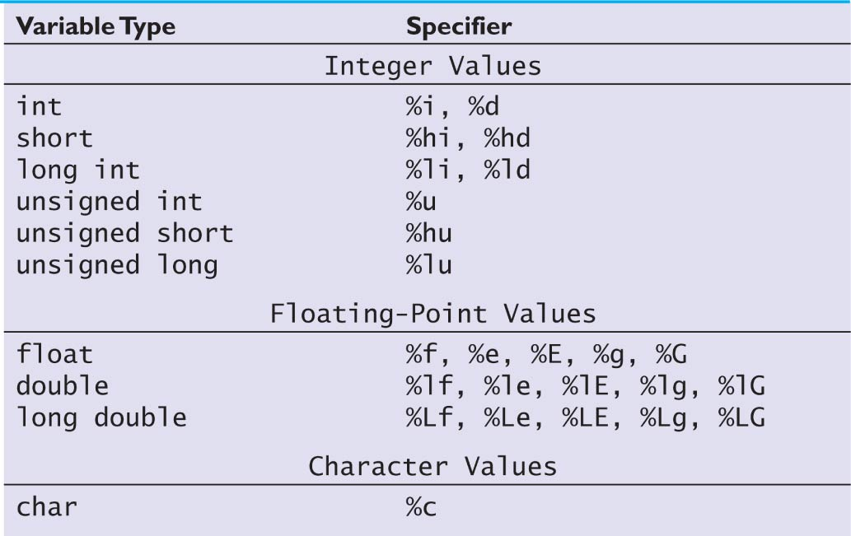
Some Specifiers for printf & scanf
Frequently Used

Slide 45
Specifier Output for printf
Output of -145 Output of 157.8926
Specifier | Value Printed
%i | -145
%4d | -145
%3i | -145
%6i | __-145
%-6i | -145__
%8i | ____-145
%-8i | -145____
Specifier | Value Printed
%f | 157.892600
%6.2f | 157.89
%7.3f | 157.893
%7.4f | 157.8926
%7.5f | 157.89260
%e | 1.578926e+02
%.3E | 1.579E+02

